Slide 1

WATER QUALITY MONITORING SYSTEM USING IOT
Velammal College of engineering and technology Madurai
(Autonomous)
Department of EEE
Final Review
Presented by
M.Nithyashri – 913120105022
S.Sofia - 913120105037
K.Sureka Harini - 913120105038
Guided by
Mr.A.Madhan
Assistant Professor/EEE

Slide 2
Objectives
In order to keep the health of any aquaculture system at an optimal level, certain water quality parameters must be monitored and controlled.
To design an low cost and robust system, to monitor water quality problem for drinking water.

Slide 3
Literature Survey
S.no | Title | Author | Description
1. | Environmental wireless sensor networks | P.Corke ,T.Wark, H.Wen R.Jurdak, P.Valencia, and D. Moore | A sensor node is developed for monitoring salinity in ground waters as well as the water temperature in surface waters
2. | Thick film screen printed environmental and chemical sensor | J.Atkinson ,J.M.Glanc, M.Prakorbjanya, M.Sophocleous, R.Sion, and E. Garcia-Breijo. | Thick film chemical sensor arrays developments show that it is possible to develop a single miniaturized multi-parametric sensor probe in a cost effective manner, however thick film chemical sensors have limited lifetime, suffer from electrode drift and the development of a stable reference electrode is not possible.

Slide 4
S.no | Title | Author | Description
1. | ISFET based micro sensors for environmental monitoring | C. Jimenez-Jorquera, J. Orozco, and A. Baldi | ISFET based micro sensors offer advantages such small size, robustness, low output impedance and rapid response, however they have several limitations as they require a glass reference electrode to operate robustly and encapsulation is difficult, which increases dramatically the final cost of the sensors.
2. | Flat Surface Operating Principles. | Sensorex Corporation, Garden Grove | Flat measuring surface probe method is used because is the most cost effective, passive self-cleaning method and is based on the mechanical package and design of the probe.

Slide 5
Problem Identification
Traditional methods of water quality control involve the manual collection of water samples at various locations and at different times,.
Then by laboratory and analytical techniques the quality is characterized .
Such approaches are no longer considered efficient.
The current methodology allows a thorough analysis including chemical and biological agents, it has several drawbacks:
a) long time gaps between sampling and detection of contamination
b) poor spatiotemporal coverage (small number locations are sampled)
c) it is labor intensive and has relatively high costs.
There is a clear need for continuous on-line water quality monitoring with efficient spatio-temporal resolution.

Slide 6
Proposed system
The Proposed system is designed with the water quality measurement and the distribution water management.
A SCADA based distributed monitoring is been designed to acquire the sensory data and control the distribution of water .
The proposed system consists of a distribution control unit that detects the water contamination and controls flow of the water for a large area distribution .
The water contamination is brought to centralized control scheme where the spatio temporal correlation of the water quality is analyzed .
An multi sensory detection based lazy learning algorithm is used to identify the false alarms.

Slide 7
Block Diagram
Microcontroller
Infrared sensor
LCD display
PH sensor
amplifier driver
Turbidity sensor
Power supply

Slide 8
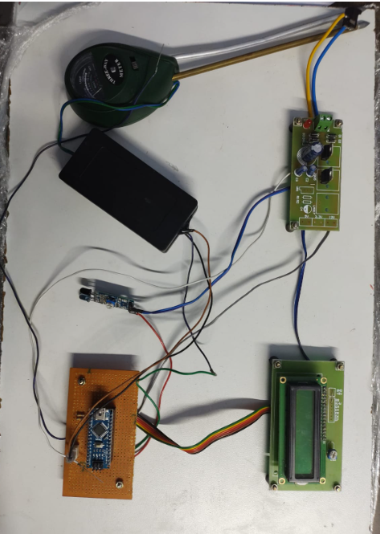
Hardware implementation

Slide 9
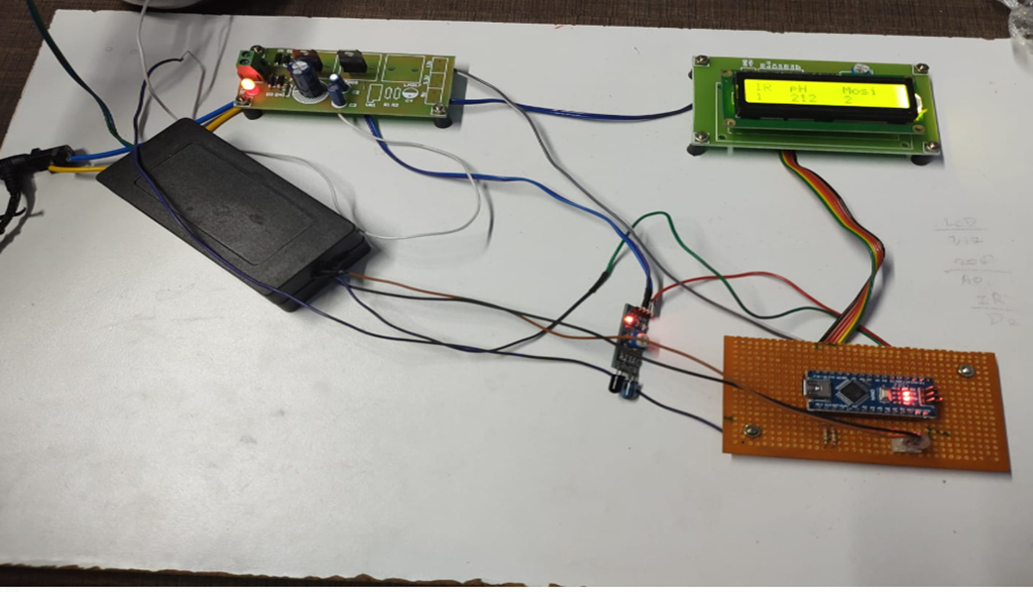
OUTPUT

Slide 10
Result
Policies for improving water quality aim to protect, restore and promote sustainable use of surface, groundwater and coastal ecosystems, halt and reverse degradation, and halt biodiversity loss.
They aim to reduce, to the extent necessary, the pollution of all waters from both diffuse and point sources of pollution.

Slide 11
Work Accomplished
REVIEW | WORK ACCOMPLISHED
0th Review | Identifying the problem, planning the project and buying the required things.
1st Review | Selection of hardware components and sensors.
2nd Review | Development of hardware.
Final Review | Implementation of hardware.

Slide 12
Cost Estimation
Arduino – Rs 1000
Sensors – Rs 3000
Power supply – Rs 1500
Relay – Rs 500
Total – Rs 6000

Slide 13
Advantages
An IoT-based water quality monitoring application is beneficial in treating wastewater before it is transferred to freshwater bodies
This is a time efficient method.
This system identifies false alarms by multi sensory detection based lazy learning algorithm.
This system is not prone to manual errors.

Slide 14
Conclusion
Thus, clean drinking water is a critical resource, important for the health and well being of all humans.
This water quality management system Is designed with the water quality measurement and the distribution water management.

Slide 15
Scope
Freshwater is a finite resource as essential to agriculture and industry as it is to basic human existence. Water quality monitoring is a fundamental tool in the management of freshwater resources.
A essential measurement node that collects water quality measurements from sensors, implements the algorithm to assess water quality and transmits data to other nodes
This system uses different sensors for monitoring the water quality by determining pH, turbidity, conductivity and temperature. The Arduino controller used will access the sensor data.

Slide 16
References
[1] T. P. Lambrou, C. C. Anastasiou, and C. G. Panayiotou, “A nephelometric turbidity system for monitoring residential drinking water quality,” in Sensor Networks Applications, Experimentation and Logistics. New York, NY, USA: Springer-Verlag, 2009, pp. 43–55.
[2] T. P. Lambrou, C. G. Panayiotou, and C. C. Anastasiou, “A low-costsystem for real time monitoring and assessment of potable water quality at consumer sites,” inProc. IEEE Sensors, Oct. 2012, pp. 1–4.
[3] S. Zhuiykov, “Solid-state sensors monitoring parameters of water qualityfor the next generation of wireless sensor networks,” Sens. Actuators B,Chem., vol. 161, no. 1, pp. 1–20, 2012.
[4] A. Aisopou, I. Stoianov, and N. Graham, “In-pipe water quality monitoring in water supply systems under steady and unsteady state flowconditions: A quantitative assessment,” Water Res ., vol. 46, no. 1,pp. 235–246, 2012.
[5] S. Panguluri, G. Meiners, J. Hall, and J. G. Szabo, “Distribution systemwater quality monitoring: Sensortechnology evaluation methodologyand results,” U.S. Environ. Protection Agency, Washington, DC, USA,Tech. Rep. EPA/600

